Slide 1
Living to Serve
Understanding the role that the Minnesota FFA Foundation
plays in supporting FFA members.

Slide 2
Vision
Engage partners to ensure agricultural education is available in every Minnesota school enabling students to have access to life-changing programs.

Slide 3
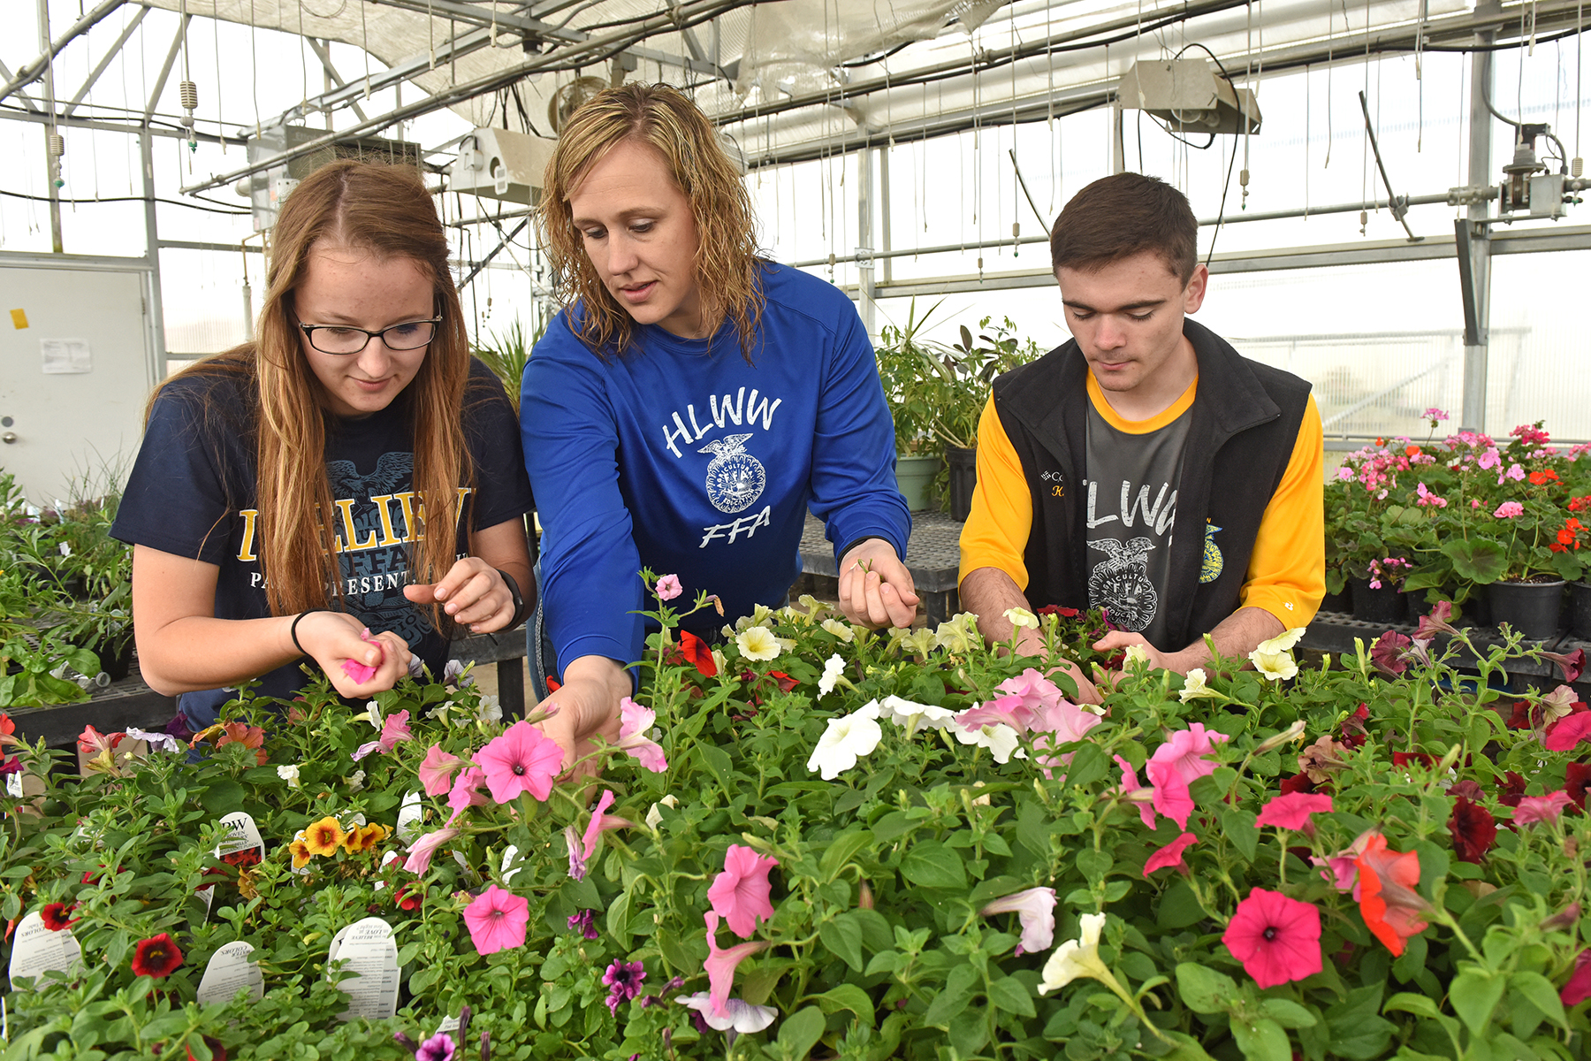
Mission
To secure strategic partnerships and financial resources that promote and enhance premier leadership, personal growth and career success for Minnesota youth in Agricultural Education.

Slide 4
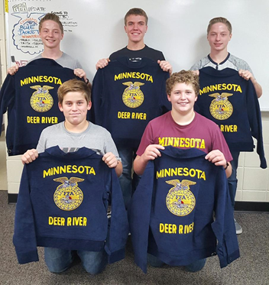
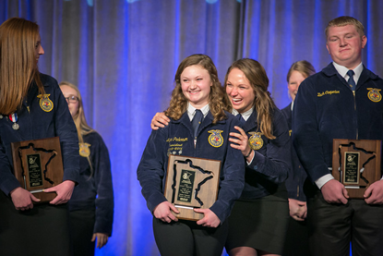
What we support…
Scholarships
Teacher Preparation
Youth Leadership
Special Projects
State Convention

Slide 5
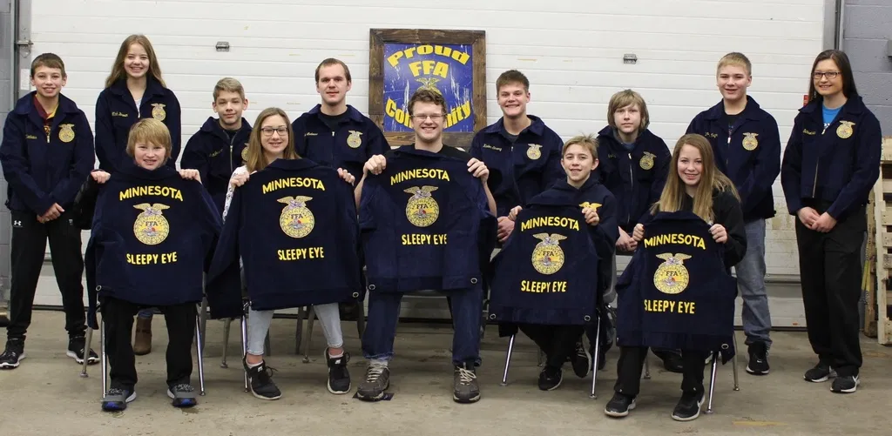
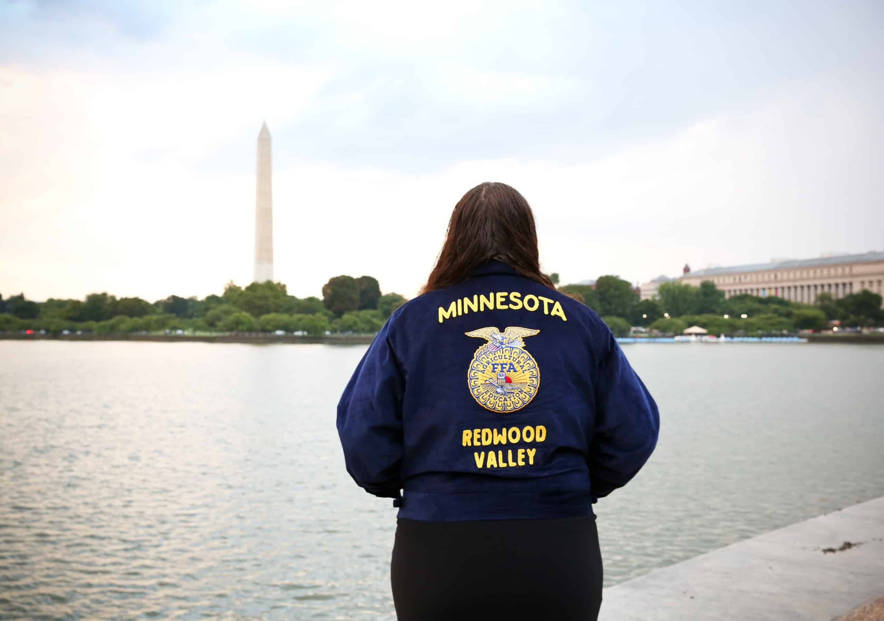
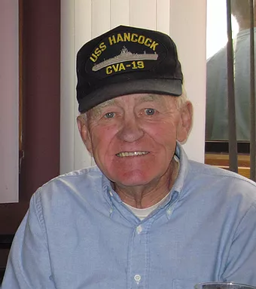
Scholarships
Blue Jackets – Bright Futures
-award hundreds of jackets each year to newer FFA members through an application process.
Washington Leadership Conference
-award scholarships to participate in the state-led group attending WLC conference.
James Tracy Scholarships
-award scholarships to participate to support youth preparing for agricultural careers at a post-secondary institution.

Slide 6
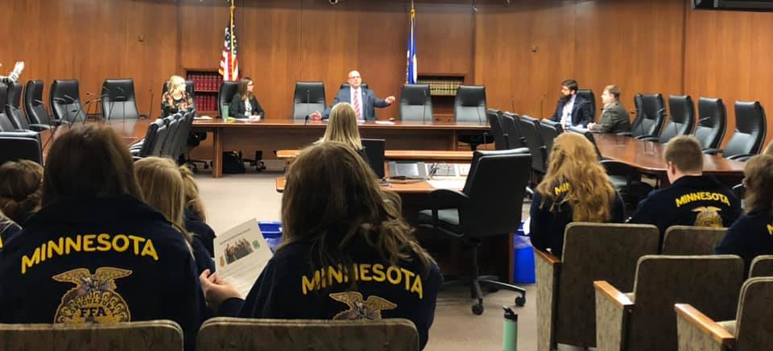
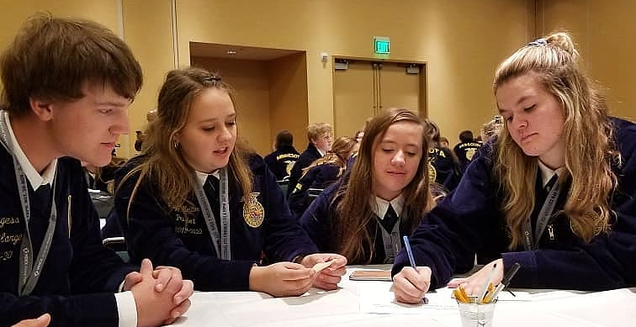
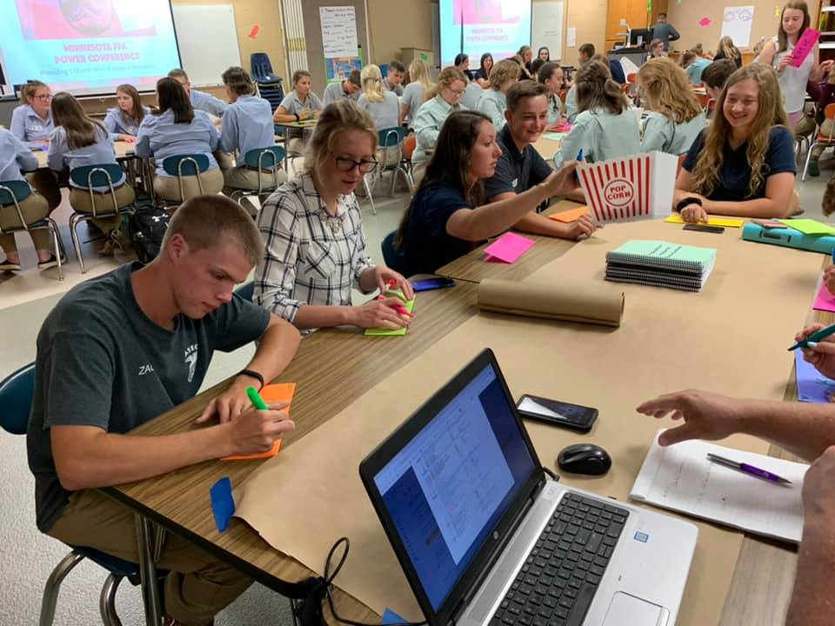
Youth Leadership
Support provided to leadership Conferences
-AgPolicy Experience, POWER, State Greenhand Conference and State Leadership Conference for Chapter Leaders

Slide 7
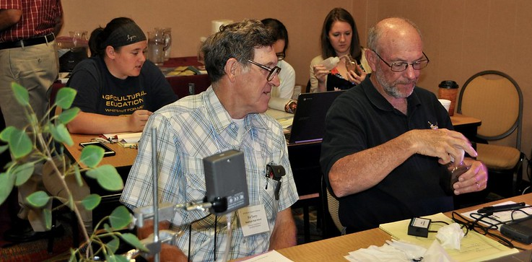
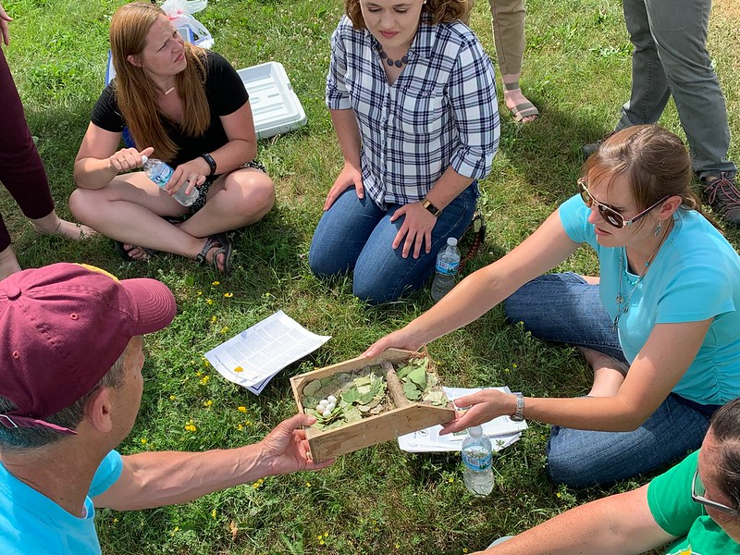
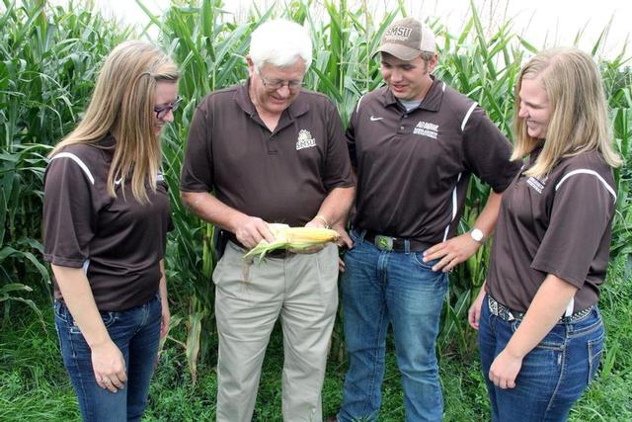
Teacher Preparation
Supporting development of future Agricultural Educators
-Southwest Minnesota State University, University of Minnesota Crookston, and the University of Minnesota Twin Cities
Supporting current Agricultural Educators
-Investing in the important work of the Minnesota Association of Agricultural Educators

Slide 8
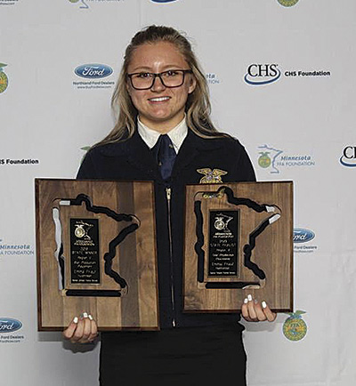
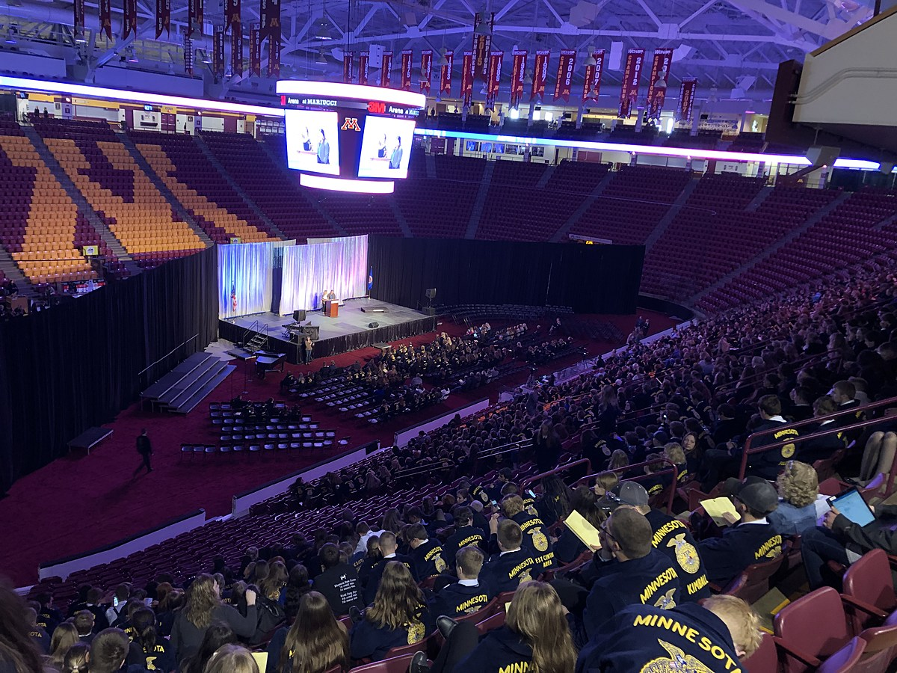
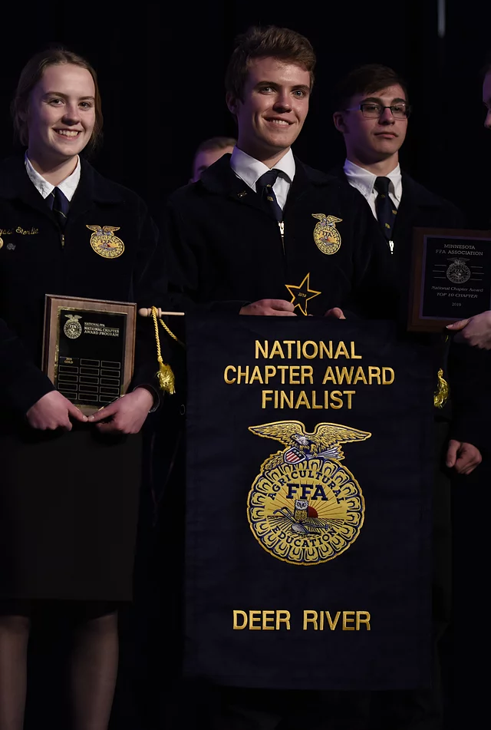
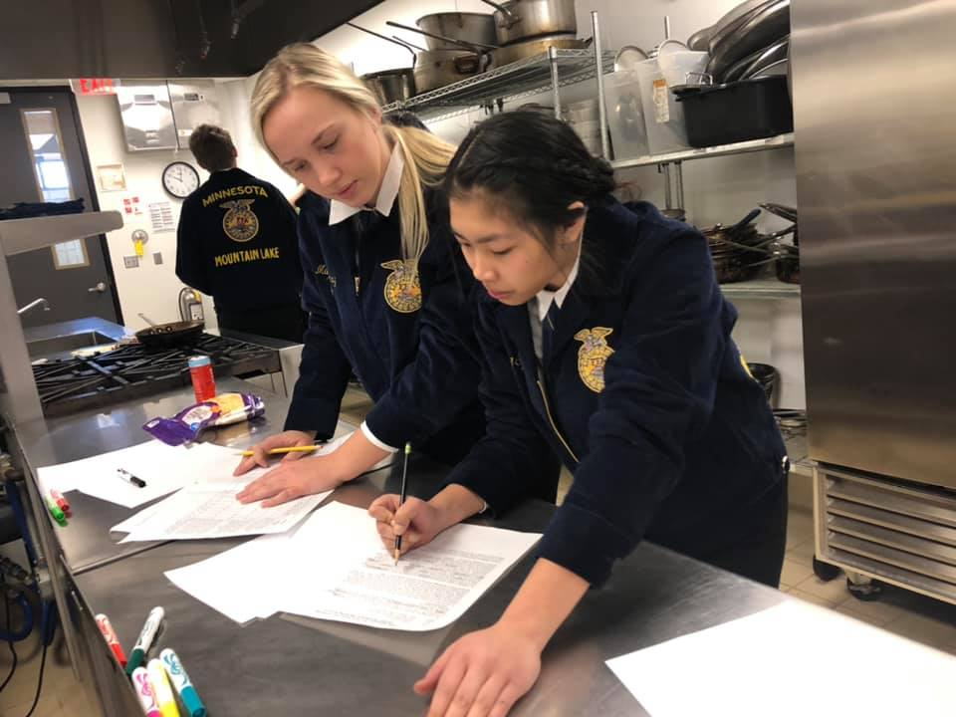
State FFA Convention
Support the many areas of the state convention including-
-Proficiency, CDE/LDE, State Stars, State Degree and other student recognition. Provide support of overall convention operating costs.

Slide 9
Support of the more than 35,000 Agriculture, Food and Natural Resources students has been made possible because of individuals like you.

Slide 10
Minnesota FFA Foundation
Will you join us as we Live to Serve?

Slide 11
Learn more at
Mnffafoundation.org

